Slide 1
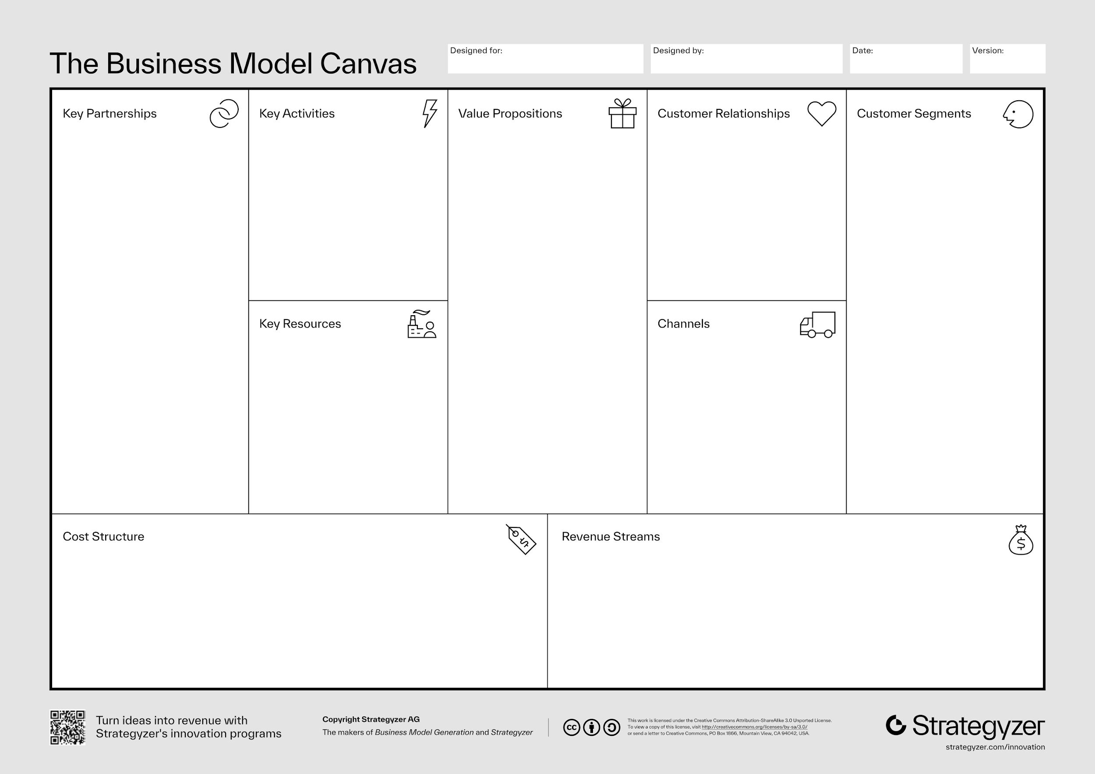
Desirability Risk
Customers aren´t interested
Real-time detection of industrial risks using computer vision.
Fully modular and scalable per zone.
Total privacy (no cloud usage).
Reduction in accidents and related costs.
Web dashboard with heatmaps, reports, and alert history.
Local learning that adapts to each factory’s specific context.
Improves worker trust and safety culture — critical for retention and morale.
Eases compliance and audit preparation with automatic logs and reports.
Ongoing technical support via SaaS.
Close collaboration with EHS teams.
Tailored setup per factory (zones, alerts).
Onboarding & training during pilot deployment.
Quarterly usage reviews to adjust alerts/zones and improve factory adaptation.
Medium to large factories with high-risk zones.
Industries: metalworking, automotive, chemical.
Key decision makers: EHS Teams, Operations Directors, OT/Digitalization Leads.
Direct B2B sales (internal sales team).
Industrial trade shows and safety events.
Targeted digital marketing (LinkedIn, email).
Partnerships with industrial systems integrators.
Direct outreach to EHS managers via LinkedIn and professional associations.
Team:
15
Date:
311/05/2025

Slide 2
Feasibility Risk
We can´t build and deliver
Suppliers of Jetson Orin NX and industrial cameras.
Industrial systems integrators.
Safety consultants and compliance experts.
UI/UX professionals for dashboard design.
Legal/regulatory advisors for safety certifications (ISO/OSHA).
Edge AI software development.
Hardware and dashboard integration.
Adapting to specific layouts/zones per client.
Technical support and system maintenance.
Continuous AI training & feedback loop management.
Skilled team in AI, embedded systems, and vision (Jetson, OpenCV, etc.).
Industrial domain expertise.
Testing infrastructure (pilots or simulated environments).
On-site databases for continuous learning.
Team:
15
Date:
311/05/2025

Slide 3
Viability Risk
We can´t make enough money
Direct module sales: €2,000 per unit.
12-month leasing: €190/month
24-month leasing: €110/month
Annual SaaS subscription per zone (e.g., €600/year)
Premium add-ons: custom reports, advanced exports, integrations
Manufacturing and assembling the modules (Jetson, cameras, enclosures)
Software development and updates
Technical support and customer success
B2B marketing and sales operations
Infrastructure for pilots and demonstrations
Team:
15
Date:
311/05/2025

